Slide 1
Working with Web Data and APIs-1
Byunggeor Moon

Slide 2
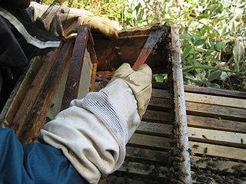
Definitions
Scraping Using tools to gather data you can see on a webpage A wide range of web scraping techniques and tools exist. These can be as simple as copy/paste and increase in complexity to automation tools, HTML parsing, APIs and programming
Scraping propolis from the sides of the bee box
Image by Abalg~commonswiki

Slide 3
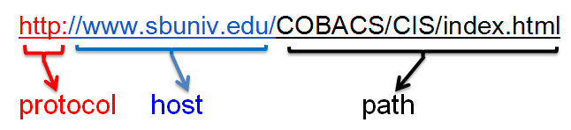

Definitions
Scraping
HTTP HyperText Transfer Protocol Machine interchange information transported over the Internet to enable multi-media data exchange, aka WWW. The protocol defines aspects of authentication, requests, status codes, persistent connections, client/server request/response. etc. Access a server on port 80; the declarative Document Type Definition ( HTML, XML, JSON, etc.)
Images from commons.WikiMedia.org

Slide 4
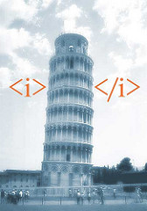
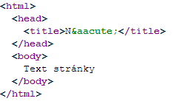
Definitions
Scraping
HTTP
HTML HyperText Markup Language The standard markup language on the Web As the web evolves so does the proliferation of technical wrappers surrounding the visible content of websites (text and data)
Image by Jesper Rønn-Jensen
Image by Michaelbrabec

Slide 5
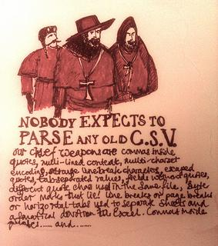
Definitions
Scraping
HTTP
HTML
Parsing The act of analyzing the strings and symbols to reveal only the data you need
Image by Paul Downey

Slide 6

Definitions
Scraping
HTTP
HTML
Parsing
Crawling Moving across or through a website in an attempt to gather data from more than one URL or page
Image by Dave Gingrich

Slide 7
Definitions
{ "firstName": "John", "lastName": "Smith", "isAlive": true, "age": 25, "address": { "streetAddress": "21 2nd Street", "city": "New York", "state": "NY", "postalCode": "10021-3100" }, "phoneNumbers": [ { "type": "home", "number": "212 555-1234" }, { "type": "office", "number": "646 555-4567" } ], "children": [], "spouse": null }
Scraping
HTTP
HTML
Parsing
Crawling
JSON Javascript Open Notation Readable text used to transmit data objects consisting of attribute-value pairs -- Wikipedia

Slide 8
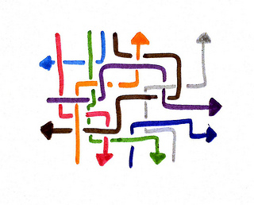
Definitions
Scraping
HTTP
HTML
Parsing
JSON
Crawling
API Application Programming Interface
A set of rules and protocols used to build a software application. In the context of Web Scraping an API is a method used to gather clean data from a website (i.e. data that is not wrapped in HTML, Javascript, bound in HTTP, etc.)
Image by Tsahi Levent-Levi

Slide 9
Web Scraping
A tremendous lure of the Internet is the availability of vast amounts of data on businesses, people, and their activity on social media.
Often a big data exploration starts with information on people:
The web can be a rich source of additional information
You have an existing core set of data and are looking to augment it
Sometimes the data are completely unstructured, existing as web pages spread across a site, and sometimes they are provided in a machine-readable form
How the crucial pieces of integration often lie in making connections between disparate data sets and how in turn making those connections requires careful quality control

Slide 10
Scraping information from the web
The simplest approach is often to manually go directly to the web and look for data ﬁles or other information
http://nsf.gov/awardsearch/download.jsp
https://rt.molit.go.kr/
https://www.uscis.gov/tools/reports-and-studies/h-1b-employer-data-hub
Sometimes data are available only on web pages or we only want a subset of this information.
In this case web scraping is often a viable approach

Slide 11
Web Scraping
Web scraping involves using a program to download and process web pages directly
Highly eﬀective, particularly where tables of information are made available online
Useful incases where it is desirable to make a series of very similar queries
Sometimes data are available only on web pages or we only want a subset of this information.

Slide 12
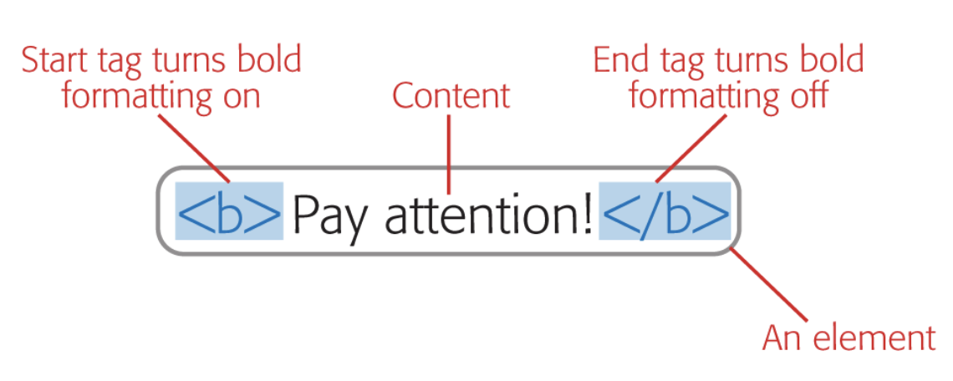
Web Scraping

Slide 13
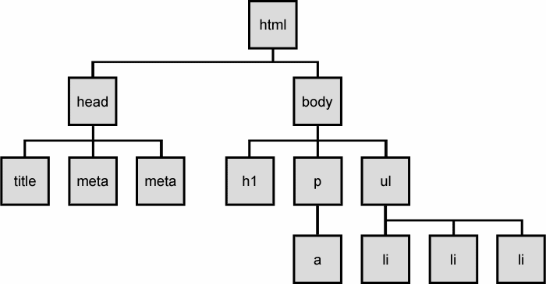
Web Scraping

Slide 14
Web Scraping
BeautifulSoup
BeautifulSoup is an amazing parsing library in Python that enables the web scraping from HTML and XML documents.
BeautifulSoup automatically detects encodings and gracefully handles HTML documents even with special characters. We can navigate a parsed document and find what we need which makes it quick and painless to extract the data from the webpages. In this article, we will learn how to build web scrapers using Beautiful Soup in detail

Slide 15
Web Scraping
Scrapy
Scrapy is a Python framework for large scale web scraping. It gives you all the tools you need to efficiently extract data from websites, process them as you want, and store them in your preferred structure and format.

Slide 16
Web Scraping
Selenium
Selenium is another popular tool for automating browsers. It’s primarily used for testing in the industry but is also very handy for web scraping

Slide 17
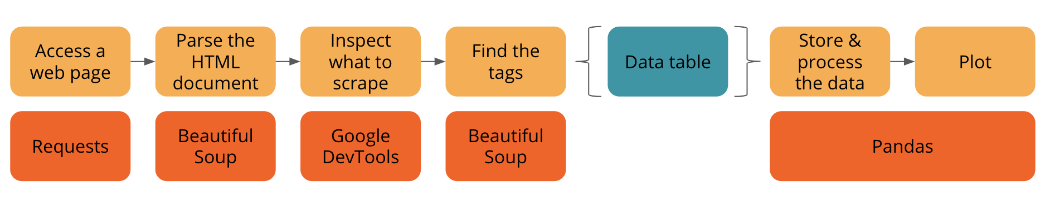
Web Scraping

Slide 18
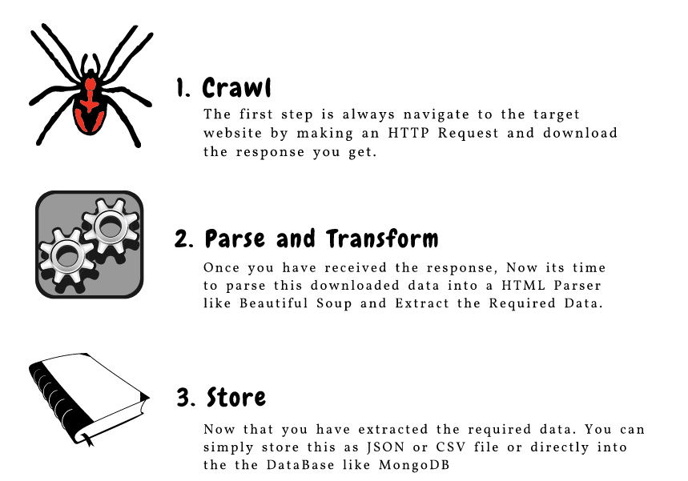
Web Scraping

Slide 19
Scraping information from the web-1
네이버 기사 수집

Slide 20
Scraping information from the web-2
네이버 금융 자료 수집

Slide 21
Scraping information from the web-2
네이버 바이크 자료수집

Slide 22
Limits of scraping
Many websites are designed in ways that make scraping diﬃcult or impossible
Other sites explicitly prohibit this kind of scripted analysis
https://www.ons.gov.uk/aboutus/transparencyandgovernance/datastrategy/datapolicies/webscrapingpolicy
In many cases a better choice is to process a data dump from an organization

Slide 23
New data in the research enterprise
The new forms of data-discussion, reading, and bookmarking
The ﬁrst is information on new forms of research output, data sets, software, and in some cases physical resources
Takes the alternate route, providing new forms of information on existing types of output, speciﬁcally research articles

Slide 24
Citations
Most quantitative analyses of research have focused on citations from research articles to other research articles. Many familiar measures—such as Impact Factors, Scimago Journal Rank, or Eigenfactor

Slide 25
Citations
Kind of usage
Citing a scholarly work is a signal from a researcher that a speciﬁc work has relevance to, or has inﬂuenced, the work they are describing.
It implies signiﬁcant engagement and is a measure that carries some weight.
Users
Researchers, which means usage by a speciﬁc group for a fairly small range of purposes.
With high-quality data, there are some geographical, career, and disciplinary demographic details.

Slide 26
Citations
Limitations
The citations are slow to accumulate, as they must pass through a peer-review process.
It is seldom clear from raw data why a paper is being cited.
It provides a limited view of usage, as it only reﬂects reuse in research, not application in the community.
Sources
PubMed, Thomson Reuters’ Web of Knowledge and Elsevier’s Scopus

Slide 27
Page views and downloads
Number of times articles are viewed
Page views are an immediate measure of usage
Drawing demographic information from downloads has signiﬁcant potential for the future in providing detailed information

Slide 28
Page views and downloads
Kind of usage
It counts the number of people who have clicked on an article page or downloaded an article.
Users
Page views and downloads report on use by those who have access to articles. For publicly accessible articles this could be anyone; for subscription articles it is likely to be researchers.

Slide 29
Page views and downloads
Limitations
Page views are calculated in diﬀerent ways and are not directly comparable across publishers. Standards are being developed but are not yet widely applied.
Counts of page views cannot easily distinguish between short-term visitors and those who engage more deeply with an article.
There are complications if an article appears in multiple places, for example at the journal website and a repository
Sources
PubMed, Figshare and Dryad
https://www.similarweb.com/, https://support.google.com/google-ads/answer/2375431?hl=ko

Slide 30
Analyzing bookmarks
Tools for collecting and curating personal collections of literature, or web content
Provide evidence of scholarly interest
Correlate quite well with the eventual number of citations

Slide 31
Analyzing bookmarks
Kind of usage
Provide evidence of scholarly interest
Correlate quite well with the eventual number of citations
Users
geographical bias towards North America and Europe

Slide 32
Discussions on social media
Social media are one of the most valuable new services producing information
First, among a large set of conversations, it is possible to discover a discussion about a speciﬁc paper
Twitter makes it possible to identify groups discussing research and to learn whether they were potential targets of the research
Possible to reconstruct discussions to understand what paths research takes to users

Slide 33
Discussions on social media
Kind of usage
It is possible to navigate to tweets and determine the level and nature of interest.
Conversations range from highly technical to trivial, so numbers should be treated with caution.
Highly tweeted or Facebooked papers also tend to have signiﬁcant bookmarking and citation.
Professional discussions can be swamped when a piece of research captures public interest..

Slide 34
Discussions on social media
Limitations
Biased towards researchers and against groups not
demographic issues and reinforcement eﬀects—retweeting leads to more retweeting in preference to other research

Slide 35
Another Possible Outcomes Indicator
Research Idea-Outcome Variable-Model Design
https://netpeaksoftware.com/blog/75-web-scraping-examples-that-will-save-your-time

Slide 36
APIs and resources
RESTful APIs work directly over the web

Slide 37
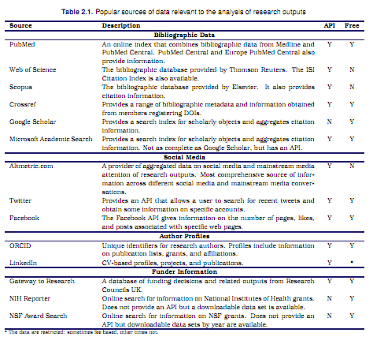

Slide 38
APIs and resources
서울시 대기질 Open API

Slide 39
Quality, scope, and management
Integration
Known identiﬁer (a DOI or an ORCID).
Integrating data from Crossref to supplement the information from an ORCID proﬁle is possible, but it depends
Coverage
Without a population frame, it is diﬃcult to know whether the information that can be captured is comprehensive
“the research literature”?
Scopus, Web of Knowledge vs PubMed, Crossref

Slide 40
Quality, scope, and management
Completeness
Alongside the question of coverage (how broad is a data source?), with web data and opt-in services we also need to probe the completeness of a data set
66 of 70 objects have a DOI registered
Does not mean that those four other objects do not have a DOI, just that there are none included in the ORCID record
Source and validity
Scopus ﬁnds 40, while Web of Science ﬁnds only 38.
A Google Scholar search performed on the same date identiﬁed 59.
The distinction lies in diﬀerences in the methodology used to mine the corpus for citations

Slide 41
Quality, scope, and management
Identifying the underlying latent variable
These issues multiply as we move into newer forms of data
These sparse and incomplete sources of data require diﬀerent treatment than more traditional structured and comprehensive forms of data
Can provide new insight

Slide 42
Ethical considerations
If you have a public API that provides the data I’m looking for, I’ll use it and avoid scraping all together.
I will only save the data I absolutely need from your page.
I will respect any content I do keep. I’ll never pass it off as my own.
I will look for ways to return value to you. Maybe I can drive some (real) traffic to your site or credit you in an article or post.
I will respond in a timely fashion to your outreach and work with you towards a resolution.
I will scrape for the purpose of creating new value from the data, not to duplicate it.
ethical web scraping
important components

Slide 43
Ethical considerations
Read the Terms of Service and Privacy Policies of a website before scraping it (this might not be possible in many situations though).
If it’s not clear from looking at the website, contact the webmaster and ask if and what you’re allowed to harvest.
Be gentle on smaller websites
Run your scraper in off-peak hours
Space out your requests.
Identify yourself by name and email in your User-Agent strings.
Inspecting the robots.txt file for rules about what pages can be scraped, indexed, etc.

